Slide 1
2025 Staff Ride Student Assignments
3 May 2025

Slide 2
Battle Analysis
Step 1: Define the Subject. (Group 1)
Step 2: Set the Stage. (Groups 1,2,3)
Step 3: Describe the Action. (Group 2,3,4,5)
Step 4: Assess the Significance. (Group 6)

Slide 3
Battle Analysis Assignment
Student Instructions:
Each group will brief a portion of the battle to facilitate understanding of the conflict in 1877 between the Non-Treaty Nez Perce and COL Gibbon’s 7th Infantry Regiment. 3 visual aides will be provided to you to assist the briefing, defined at the end of the slide deck.
Determine what group you are assigned to.
With your group, review the question that corresponds to your group number.
Utilize the references in slide 5 to pinpoint answers in the Student Book of Readings.
Once you have finished the assigned readings, you will be able to brief your portion of the battle. Use the Running Estimate slides at the end of the slide deck to build your brief. This is not an Essay, it is a briefing.
Be prepared to brief your portion for rehearsal 2 MAY 2025.

Slide 4
Resources
Student Book of Readings (SBR)- Big Hole Battlefield
Visual Aides (35” x 51” approximate size).
Park Service map of battle sequence
Landscape view of modern battlefield
Regional Map from Eastern Oregon to Eastern Montana (Available 1 APR)
Nez Perce Reservation boundary map 1855 vs 1863
Skirmish Line drawings from Scott- “A sharp little affair” (SBR)

Slide 5
Group Assignments (24 Pax?)
Topic | Group | Names | Briefing Time
Operational and Strategic Overview | 1 |  | 20 min
7th Regt Attack plan | 2 |  | 15 min
Nez Perce posture | 3 |  | 15 min
Nez Perce counter attack | 4 |  | 15 min
7th Regt Defense posture | 5 |  | 15 min
Lessons learned | 6 |  | 20 min

Slide 6
Cadet Vignette Assignments
Group assignments are listed below. Readings are all found in the Student Book of Readings. The page numbers are in reference to the original text as excerpted in the readings. Use the table of contents in the SBR to find the author being referenced.
Topic | Group | Start and Stop | Readings
Operational and Strategic Overview | 1 | Grangeville to Ft. Fizzle. Political and Social status of the United States, western US expansion. | (Green 1-5, 8-16, 20-23,26-35,58,62-64,93-97) (McDonald 113-114) (Oberholtzer 3-5) (Sherman 902-903) (Wiley)
7th Regt Attack plan | 2 | Ft. Fizzle to occupying the limit of advance on the objective. | (Haines 26-28, 47-49,51-52,54,58, 60,64-66) (Greene 124-125, 129-130) (Gibbon 1,3,5-6) (Woodruff 107,109) (Gibbon Article 2) (Woodruff Letter)
Nez Perce posture | 3 | Ft. Fizzle to the end of the initial assault by 7th Regt on the lodge site | (Haines 23-30,35,49,51-52,55-56,58,61,63)(McDonald 75-77)(Greene 132,)(Gibbon 7)
Nez Perce counter attack | 4 | Counter-firing on the 7th Regt in lodge site to 11 p.m. departure from Big Hole valley | (Greene 134-135,137) (Haines 59,65-66,71-77) (Gibbon 7) (Woodruff 110) (Loynes 5-6) (McDonald 78)
7th Regt Defense posture | 5 | Limit of advance on the objective, cessation of the assault by the Nez Perce | (Greene 136,138) (Haines 74- 83,87-90,95-96)(Gibbon 7) (Loynes 12)(Woodruff 111)
Lessons learned | 6 | End of Battle at Big Hole, Bear Paw surrender, implications for American West. | (Haines 113-114, 135-136) (Gibbon letter)(Gibbon Article) (Woodruff 107-113) (Woodruff Letter) (McWhorter 220-225)( Mintz) (Howard 537-539) (Sherman at 902-903) (Greene 327-328)

Slide 7
Cadet Vignette Assignments
Operational and Strategic Overview
Group 1
30 minutes PMESII-PT analysis
Explain the context of the Nez Perce War in 1877 from the perspective of PMESII-PT. President Grant (Political),GEN Sherman (military), , Isaac Stevens (economic), White Bird, Looking Glass, Joseph, and regarding the 1855 and 1863 treaties (Social). Include the impact of the news of the 15 murders IVO Grangeville that sparked activity in the Missoula Valley (information). Explain the terrain layout on the provided map, the availability of improved roads (infrastructure), and the time it took for operations to happen over said terrain in 1877. Focus the end of your overview to events immediately leading up to the Big Hole battle to include the where (Physical Environment) and when (Time ) events of the battle occurred.

Slide 8
Cadet Vignette Assignments
7th Regiment plan of attack
Group 2
20 minutes METT-TC Analysis
Describe the perspective of the 7th Regiment from the lens of METT-TC. Summarize the orders and endstate put forth to LTC Gibbon and his corresponding plans for the Big Hole encampment(M). Describe the 7th Regiment’s understanding of the non-treaty Nez Perce bands (E) with regard to their location, composition, and disposition. What terrain features separated the 7th Regiment from their objectives(T). Summarize LTC Gibbon formation in terms of composition, disposition, and strength (T). Explain how timing affected the operations (T).Summarize civil considerations that were part of the 7th Regiment’s planning decisions, or at the very least, rules of engagement that guided their decisions(C).

Slide 9
Cadet Vignette Assignments
Nez Perce posture
Group 3
20 minutes METT-TC analysis
Describe the perspective of the non-treaty Nez Perce from the lens of METT-TC. Summarize the desires of the Non-treaty bands and their desired endstate in their flight to the east (M). Describe the non-treaty Nez Perce understanding of the 7th Regiment’s location, composition, and disposition (E). What major terrain features separated the groups from their opponents (T). Summarize the roles of White Bird, Looking Glass, Joseph, and Toohoolhoolzote, and the composition of their collective force(T). Describe the effects of weather on decisions and movement (T). Summarize civil considerations that were part of the Nez Perce planning decisions, or at the very least the nature of their interactions with settlers in the Bitterroot valley (C).

Slide 10
Cadet Vignette Assignments
Nez Perce Counter-attack
Group 4
20 minutes METT-TC analysis
What is the new mission of the Nez Perce after LTC Gibbon’s initial attack (M). Describe Nez Perce understanding of the dispersion of 7th Regiment forces (E). What were the implications of terrain now?(T). What was the current composition and disposition of Nez Perce fighters after the initial attack(T). How was time now affecting the initiative for offense/defense (T). Now that the encampment has become a battlefield, what is the Nez Perce plan for non-combatants(C).

Slide 11
Cadet Vignette Assignments
7th Regiment defensive posture
Group 5
20 minutes METT-TC analysis
What is LTC Gibbon’s intent in occupying a defensive posture (M). Describe 7th Regt’s understanding of the enemy force opposing him now (E). What were the implications of terrain now?(T). What was the current composition and disposition of 7th Regt’s fighters after the initial attack(T). How was time now affecting the initiative for offense/defense (T). Now that the hill has become a defensive area, are there any non-combatants to consider?(C).

Slide 12
Cadet Vignette Assignments
Lessons Learned
Group 6
30 minutes PMESII-PT analysis
Describe the changes to the political landscape following the battle of the Big Hole(P). Briefly explain the key campaign notes after the Battle of the Big Hole to include surrender and extradition of the Nez Perce (M). What was the economic impact of subduing the Nez Perce across the western Montana region (E), and the corresponding social effects on both populations in the area (S). Who controlled the narrative of the events that transpired at the Big Hole Battle, and what was the effect on perception of both sides (I). With hostilities subdued, what major infrastructure development proceeded in 1878 (I)? What were the lessons learned during the actual Battle? What intelligence was available to each side? Was their assessment of their opponents accurate? With the information they had at the time, were the decisions they made defendable?

Slide 13
Running Estimate
Facts
Assumptions
Constraints
Limitations

Slide 14
Running Estimate
Friendly Status
Enemy Activities and Capabilities
Civil Considerations
Conclusions and recommendation (Risk)

Slide 15
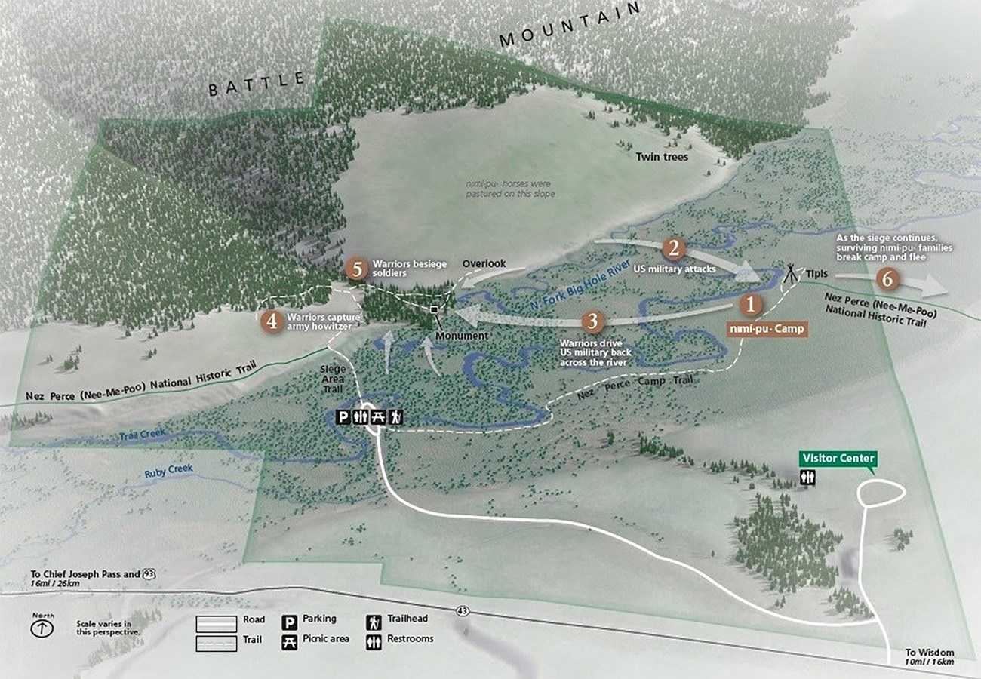

Slide 16
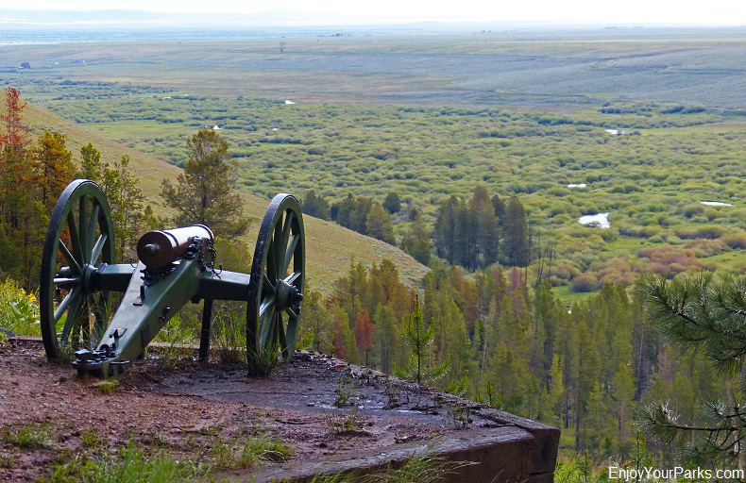

Slide 17
